Slide 1
CABIN DWI Workshop
Day 2
DWI Preprocessing
Alan Finkelstein

Slide 2
Overview
Gibbs Ringing
Denoising
Motion Correction
Eddy current correction
Susceptibility Correction
Scripting

Slide 3
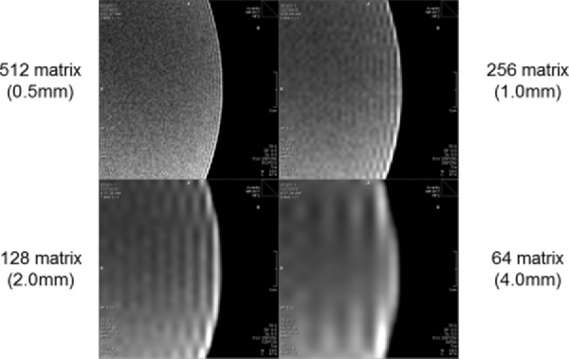
Gibbs Ringing
Magn Reson Med. 2016 Nov;76(5):1574-1581 doi: 10.1002/mrm.26054. Epub 2015 Nov 24.
https://dipy.org/documentation/1.5.0/examples_built/denoise_gibbs/#example-denoise-gibbs
➜ ~ mrdegibbs -h
USAGE
mrdegibbs [ options ] in out
in the input image.
out the output image.
Notes:
Occurs as a consequence of using fourier transforms to reconstruct MR signals, and are related to the number of samples taken. Because fewer samples are taken in the phase-encode direction, the artifact is typically more prominent in the phase-encoding direction. These errors can be minimized by increasing the number of phase-encoding steps or by reducing the FOV.
Ways of removing gibbs rining in post-processing include applying a Hamming window or using the total variation method.
The truncation in k-space can be interpreted as a convolution of the underlying image with a sinc-function

Slide 4
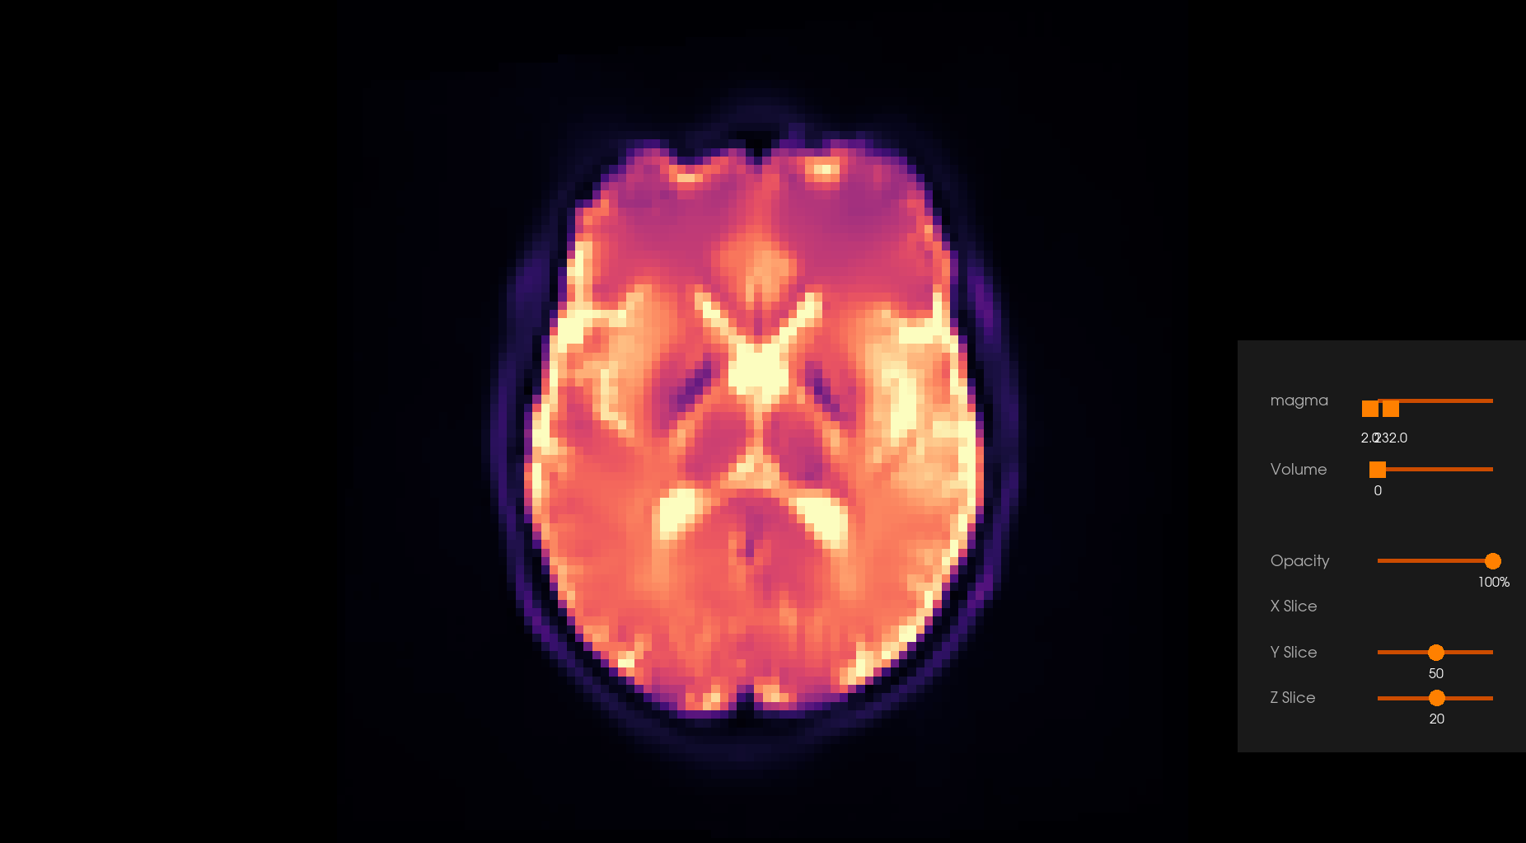
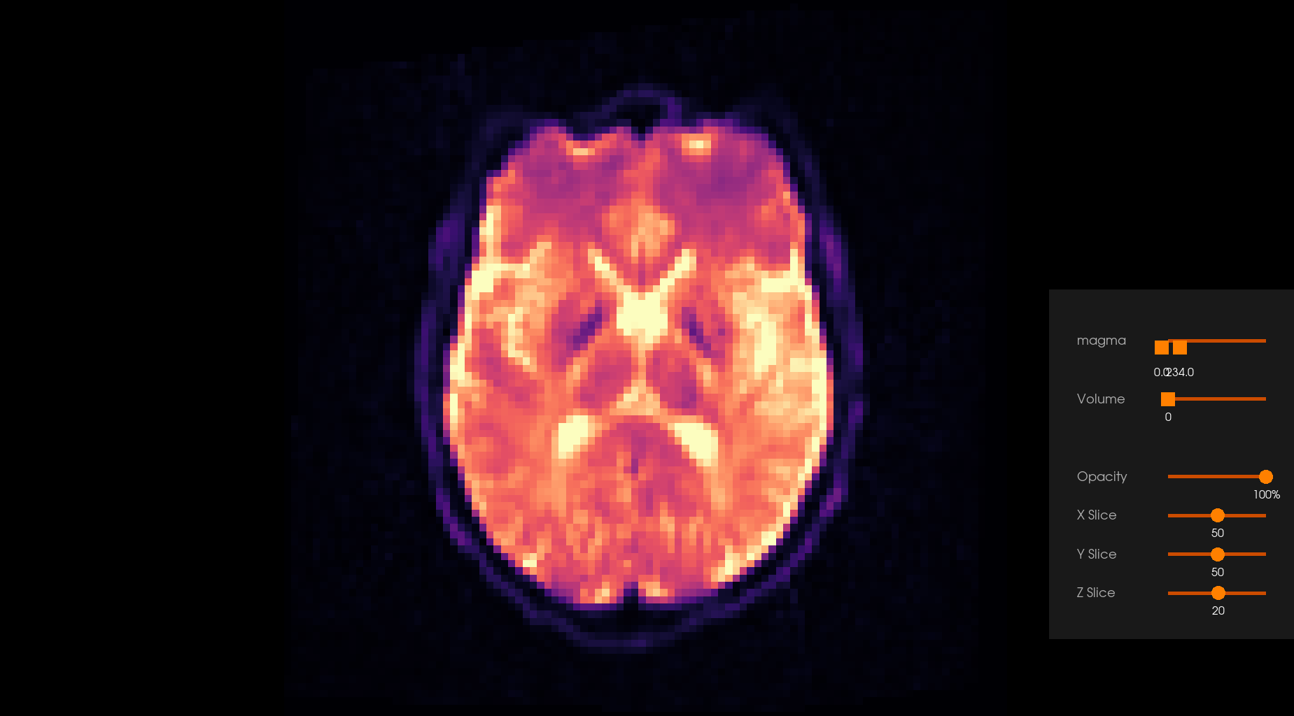
Denoising
https://dipy.org/documentation/1.4.0./interfaces/denoise_flow/
Others such as Patch2Self(DIPY)
DWI data has relatively low SNR.
Various methods exist in DIPY and MRtrix3 – usually some variant of PCA based denoising
➜ ~ dwidenoise
USAGE
dwidenoise [ options ] dwi out
dwi the input diffusion-weighted image.
out the output denoised DWI image.
Notes:
Exploit redundance of the data in DWI. Perform a low-rank approximation by thresholding the eigenspectrum of the noisy signal matrix.
Estime the noise variance at each voxel, apply PCA in local patches around each voxel, threshold the eigenvalues and then do PCA reconstruction.

Slide 5
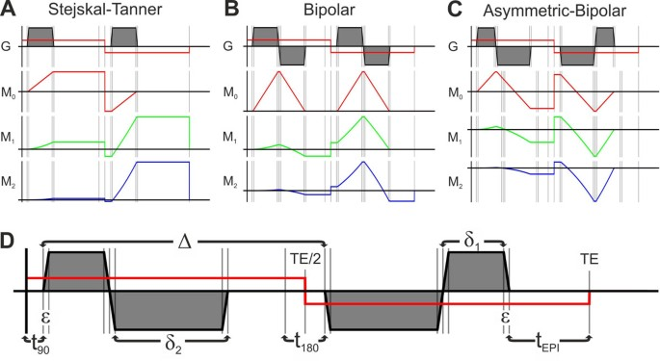
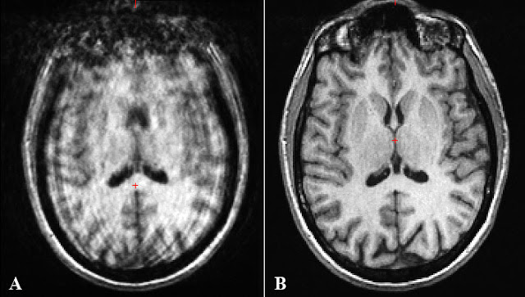
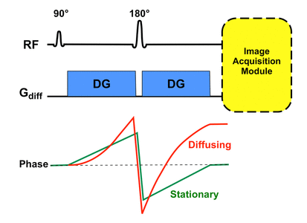
Motion Correction
Diffusion sensitizing gradients also sensitize to motion
Performed as part dwifslpreproc , along with eddy correction and susceptibility-induced distortion.
Notes:
Diffusion sensitizing gradients also sensitize to motion – such as flow. Cardiac pulsation, respiratory motion and bulk motion all contribute to signal loss during the gradient.
Conventionally use EPI sequence for imaging.
Gradient moment nulling is a technique used to reduce flow artifacts in our image and intravoxel dephasing. It is also a technique used in bright blood imaging. AKA flow compensation

Slide 6
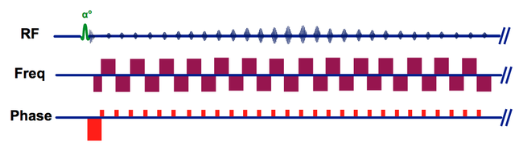
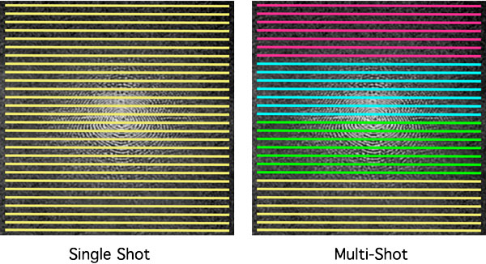
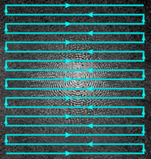
EPI Acquisition
https://mriquestions.com/echo-planar-imaging.html
Echo planar imaging, can be acquired in a single shot or in multiple shots.

Slide 7
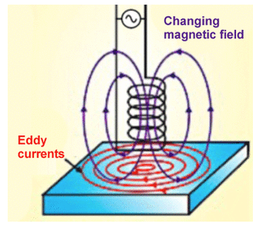
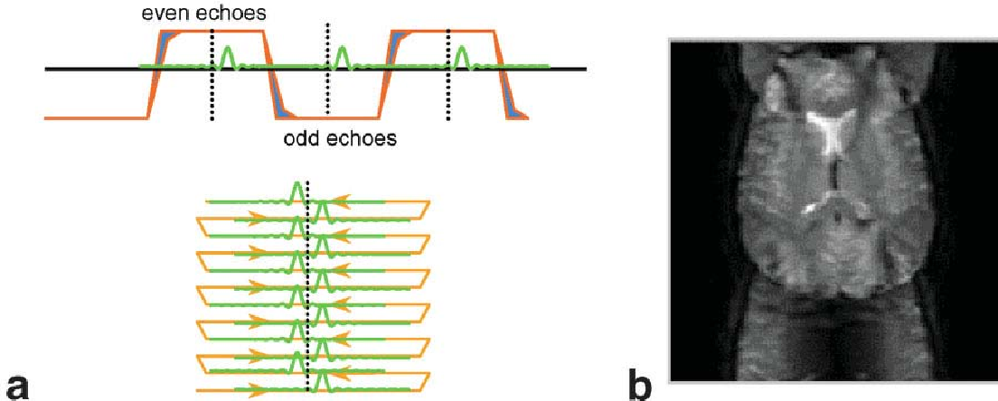
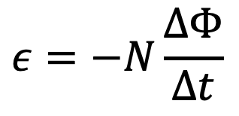
Eddy Currents
$$ε=−N\frac{ΔΦ}{Δt}$$
Faraday-Lenz Law: Rapidly changing magnetic fields induce eddy currents in MR hardware. This degrades image quality and can lead to spuriously high ADC values.
https://www.semanticscholar.org/paper/Artifacts-Caused-by-Eddy-Current-in-Diffusion-MRI-Tan/9c7ff89299f208da20929a60fb149353c590da90
Notes:
Rapidly changing magnetic fields to encode the signal, it is the rate of change of the magnetic field, fast imaging sequences produce severe eddy currents, which are particularly evident in EPI sequences.
Eddy currents create two undesired phenomena: unwanted time-varying gradients and shifts in the main magnetic field (Bo).

Slide 8
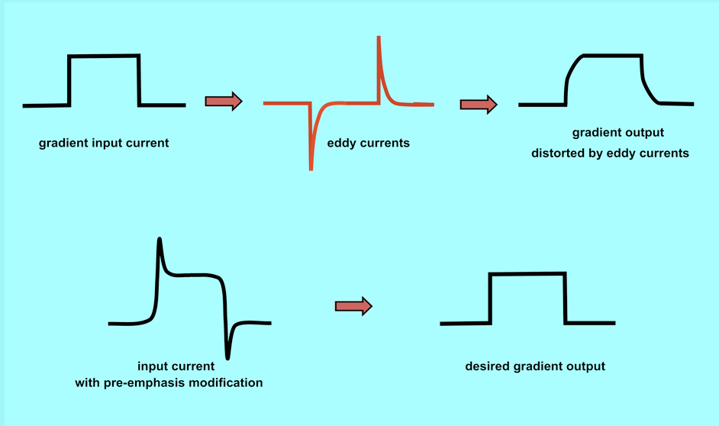
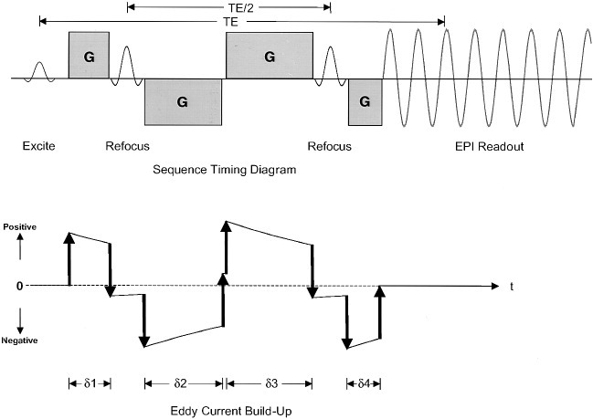
Eddy Current Correction on the Scanner
Pre-emphasis or pre-compensation is used to correct eddy current effects on the scanner, by compensating for them.
Specific pulse sequences such as TRSE have been developed to correct for eddy currents.
This is not necessary with modern post-processing techniques.
Notes:
Will wait to the end to explain dwifslpreproc

Slide 9
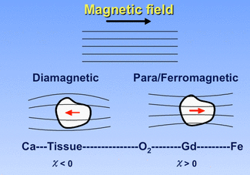


Susceptibility Distortions
Susceptibility ($χ$) is a measure of how readily magnetized something becomes when placed in an external magnetic field.
Distortions in magnetic field result in changes in precessional frequency, resulting in spatial mismapping of the MR signal.
Notes:
Paramagentic have unpaired electrons and concentrarte the field. Diamagnetic substances disperse the field.
Magnetic field distrotions result in variations of the precessional frequency causing frequency changes, resulting in spatial mismapping of the MR signal, resulting in geometric distortion with focal areas of signal void
Use a shorter TE – less time for dephasing, and avoid higher magnetic field with implants.

Slide 10
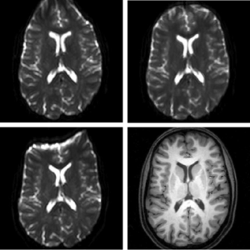
Blip-Up, Blip-Down
Collect one volume with reverse phase-encoding. Given two or more acquisitions with opposite polarities (AP and PA) topup will attempt to estimate the field by maximizing the similarity between the unwarped volumes.
Notes:
Top left is blip down, top right is bluip up.
Bottom left is AP
Top left is PA

Slide 11
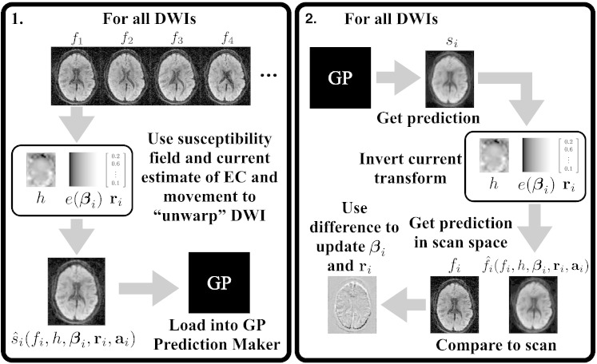
Correcting Eddy Currents in Post-Processing
Eddy and eddy_correct – uses a gaussian model to estimate the displacement maps of each diffusion direction to current eddy current induced distortions.
Notes:
Spatial model for eddy current-induced field
It is often assumed that EC-induced distortions consist of in-plane shears and zooms and translations along the PE-direction (see e.g., Haselgrove and Moore, 1996, Bastin, 1999, Bastin and Armitage, 2000, Bodammer et al., 2004, Zhuang et al., 2006). This is explained in Jezzard et al. (1998) and is predicated on the assumption that the EC-induced fields can be adequately described by a linear combination of linear gradients in the principle directions and an offset. This in turn assumes that the conductors responsible for the EC-induced fields are the gradient coils themselves because there is no reason to believe that a current in any other conductor in the bore would result in a linear gradient. In contrast others have found empirically that a low order polynomial representation of the field yields better results than the linear model (Rohde et al., 2004).
Like Rohde et al. (2004) we have found that a low (second or third) order polynomial model for the field gives better results. Therefore in the present work, there are options to model the EC-induced field as a first, second or third order polynomial. T

Slide 12
Sample Script
while getopts "hs:t:d:" flag; do case "${flag}" in h) echo -e $usage exit 0 ;; s) ROOT=${OPTARG};; t) T1W=${OPTARG};; d) DWI=${OPTARG};; *) echo -e $usage exit 1;; esac done
#!/bin/bash #SBATCH --time=2-00:00:00 #SBATCH --mem=64gb #SBATCH -p gpu --gres=gpu:1 #SBATCH --job-name="Preproc" #SBATCH --mail-user=your_email@urmc.rochester.edu #SBATCH --mail-type=END

Slide 13
mrconvert "${ROOT}/${DWI_b1000}.nii.gz" -fslgrad "${ROOT}/${DWI_b1000}.bvec" "${ROOT}/${DWI_b1000}.bval" "${ROOT}/${DWI_b1000}.mif" –force mrconvert "${ROOT}/${DWI_b2000}.nii.gz" -fslgrad "${ROOT}/${DWI_b2000}.bvec" "${ROOT}/${DWI_b2000}.bval" "${ROOT}/${DWI_b2000}.mif" -force mrconvert "${ROOT}/${DWI_PA}.nii.gz" "${ROOT}/${DWI_PA}.mif" -force mrconvert "${ROOT}/${DWI_ROOT}_T1w.nii.gz" "${ROOT}/${DWI_ROOT}_T1.mif" –force
# Gibbs Ringing # Denoise using MP-PCA dwidenoise "${ROOT}/${DWI_b1000}.mif" "${ROOT}/${DWI_ROOT}_denoised1000.mif" -force dwidenoise "${ROOT}/${DWI_b2000}.mif" "${ROOT}/${DWI_ROOT}_denoised2000.mif" -force module unload mrtrix3/b2 module load mrtrix3/b3
module load fsl export FSLOUTPUTTYPE="NIFTI_GZ" module load ants module load freesurfer module load mrtrix3/b2 source $FREESURFER_HOME/SetUpFreeSurfer.sh
Notes:
In general each step is optional

Slide 14
# combine multi-shell data dwicat "${ROOT}/${DWI_ROOT}_denoised1000.mif" "${ROOT}/${DWI_ROOT}_denoised2000.mif" "${ROOT}/${DWI_ROOT}_dwi.mif”
echo "Now preprocessing DWI data - Distortion Correction + Eddy Correction" dwiextract "${ROOT}/${DWI_ROOT}_dwi.mif" - -bzero | mrmath - mean "${ROOT}/mean_b0_AP.mif" -axis 3 -force mrmath "${ROOT}/${DWI_PA}.mif" -axis 3 "${ROOT}/mean_b0_PA.mif" -force mrcat "${ROOT}/mean_b0_AP.mif" "${ROOT}/mean_b0_PA.mif" -axis 3 "${ROOT}/b0_pair.mif" -force dwifslpreproc "${ROOT}/${DWI_ROOT}_dwi.mif" "${ROOT}/${DWI_ROOT}_dwi_preproc.mif" -nocleanup -pe_dir AP -rpe_pair -se_epi "${ROOT}/b0_pair.mif" -force #eddy options, slm = linear

Slide 15
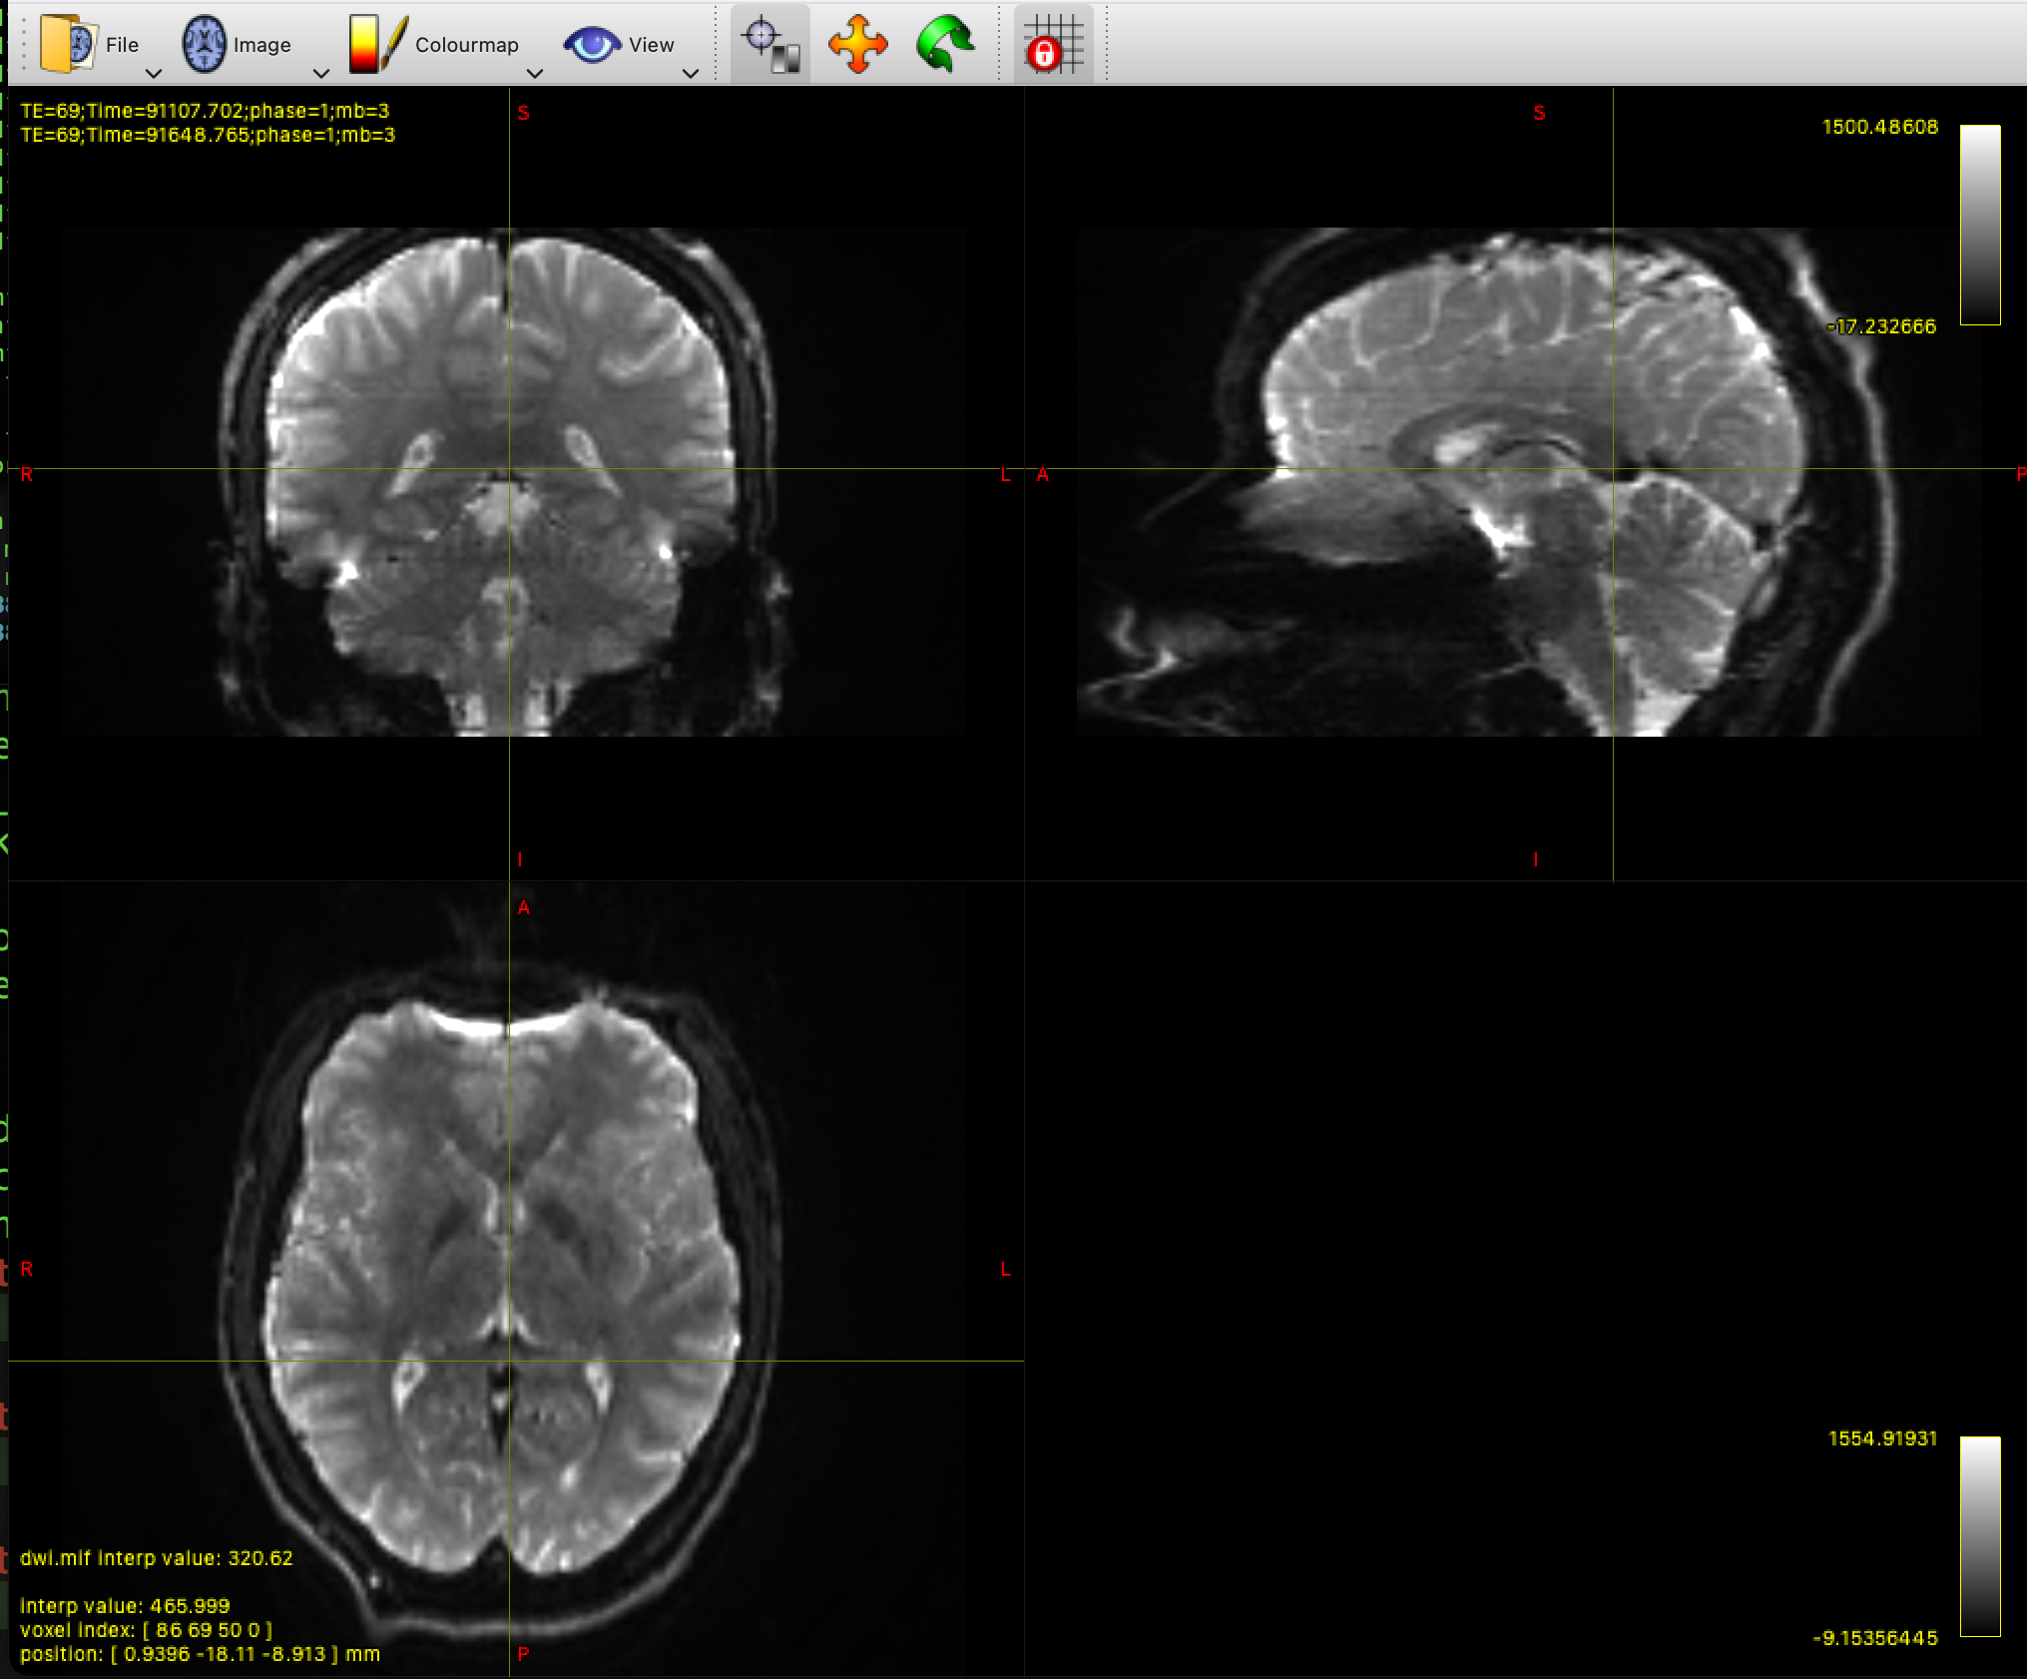
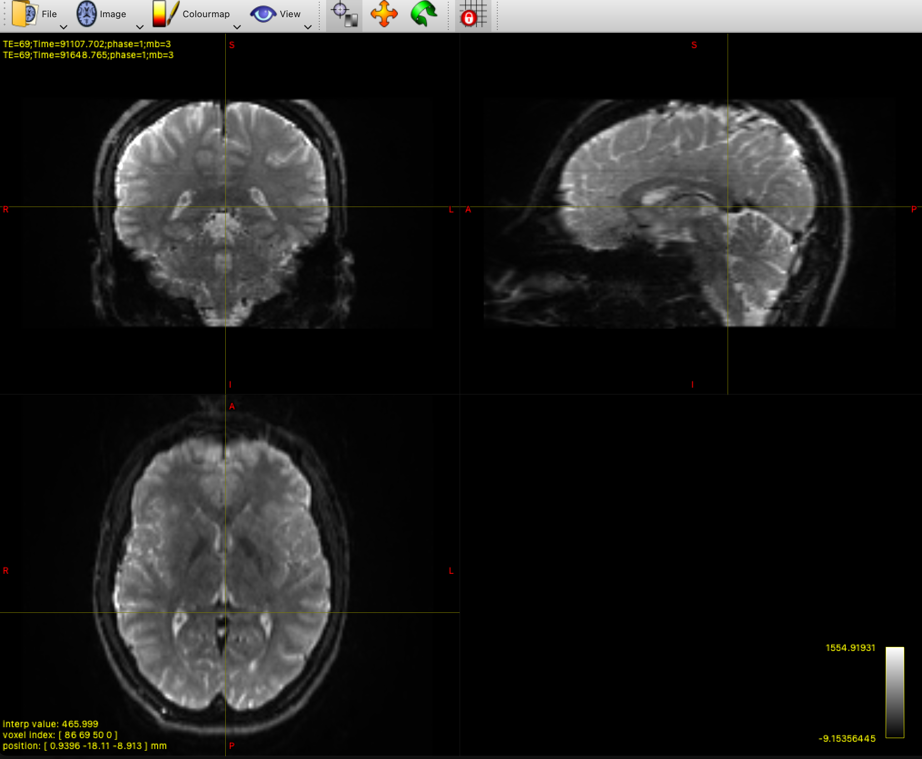
Notes:
AP acquisition

Slide 16

Additional Resources
https://dipy.org/tutorials/
https://fsl.fmrib.ox.ac.uk/fsl/fslwiki/eddy/UsersGuide https://fsl.fmrib.ox.ac.uk/fsl/fslwiki/topup
https://mrtrix.readthedocs.io/en/dev/dwi_preprocessing/dwifslpreproc.html
https://community.mrtrix.org/t/welcome-to-the-mrtrix3-support-and-discussion-forum/8 (forum).

